Slide 2
Agenda
Motivation
Theory
Methodology
Results
Conclusion

Slide 3
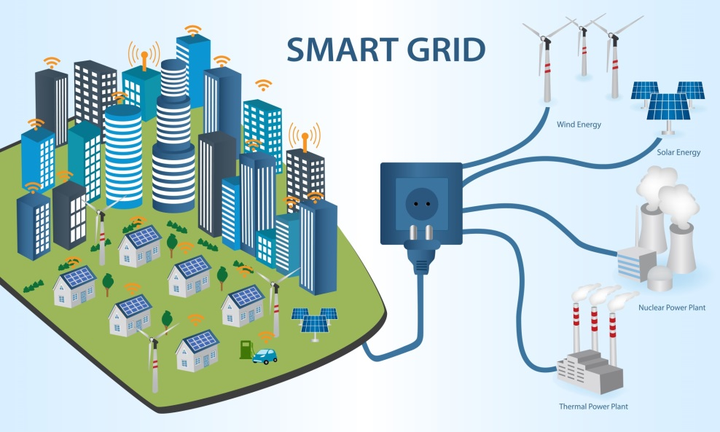
Motivation
International and regional efforts for reduction CO2 emissions.
Increase of Distributed Energy Resources (DER) share.
Current power system performance
Effects on power system performance of DER integration.
Higher ROCOF and power imbalance expected in future.
Our questions when start?
The working group want to know the necessity reaction time of inverters in term of synthetic inertia?
!!! Show the relevance of your work regarding our working group strategy!!!

Slide 4







Scientific Question
Which power reserve response would be required in future scenarios where inverter based generation is predominant?
Will conventional primary reserve be capable of avoid frequency collapses?
How much time would be required by inverters to supply power reserve?
How effective are some developed methods such as synthetic inertia?

Slide 5
Agenda
Motivation
Scientific Question
Theory
Methodology
Results
Conclusion

Slide 6
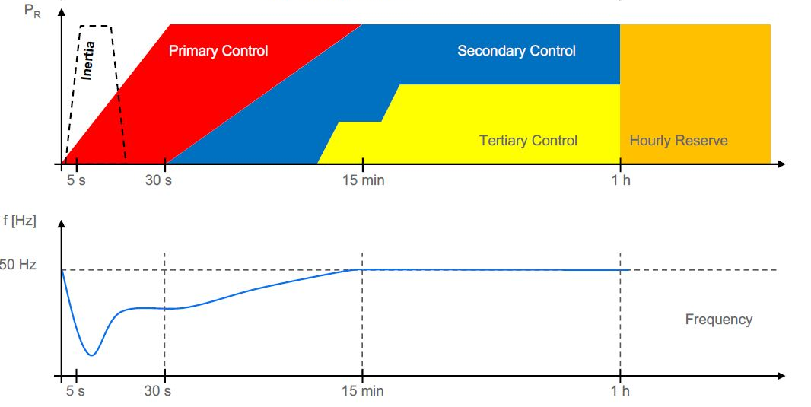
Theory Definition of Fast Power Reserve
Definition
Inertia
Current system operation based on synchronous machines
Synthetic Inertia
Fast Power Response
RoCoF
Acceleration time constant!!!!

Slide 7
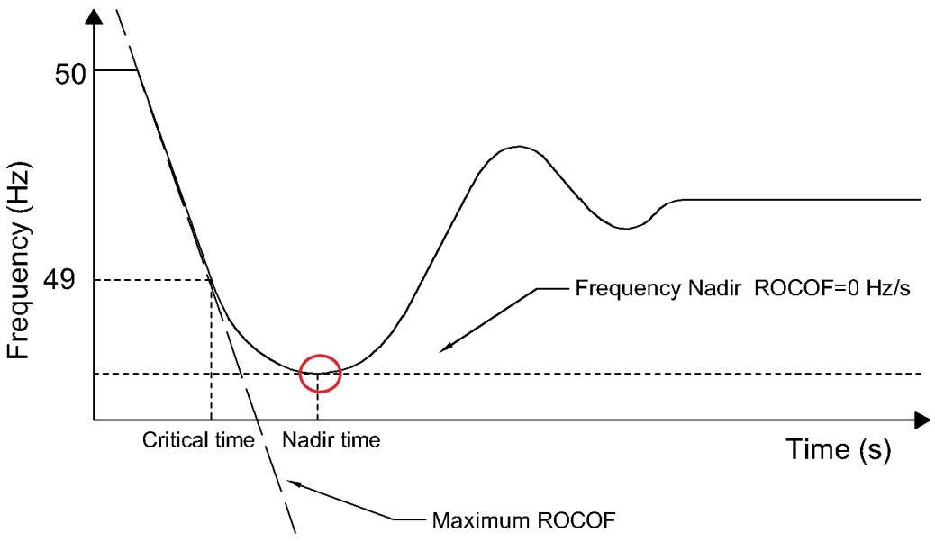
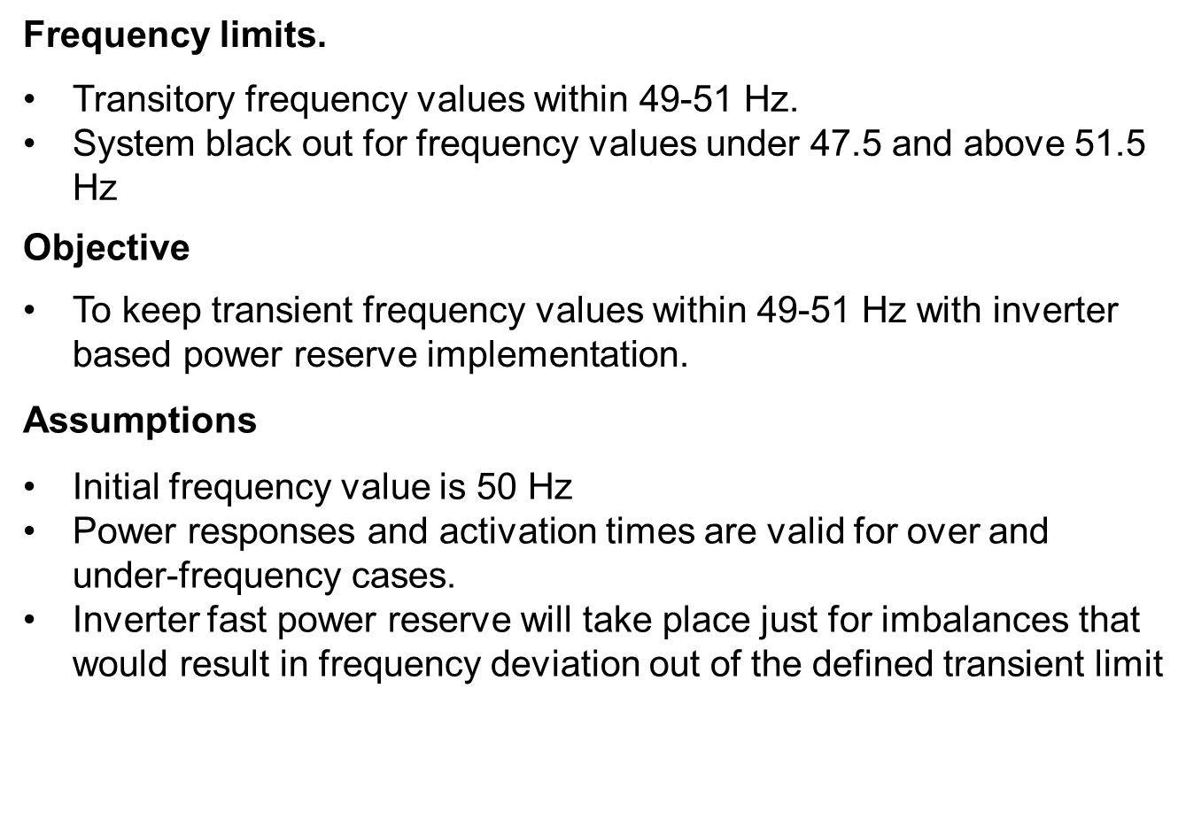
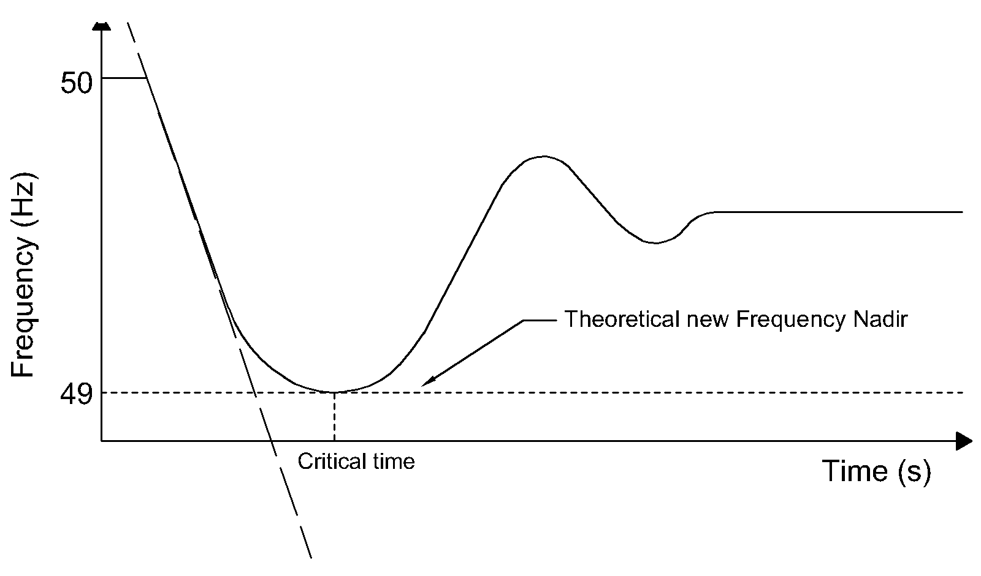
Theory
ROCOF: Rate of Change of Frequency (𝑑𝑓/𝑑𝑡)
Critical time (tcr): Time at which frequency deviates 1 Hz from nominal
Nadir time (tnadir): Time at which frequency nadir is reached
Power imbalance (ΔP): Difference between generation and load

Slide 8
Agenda
Motivation
Scientific Question
Theory
Methodology
Results
Conclusion

Slide 9
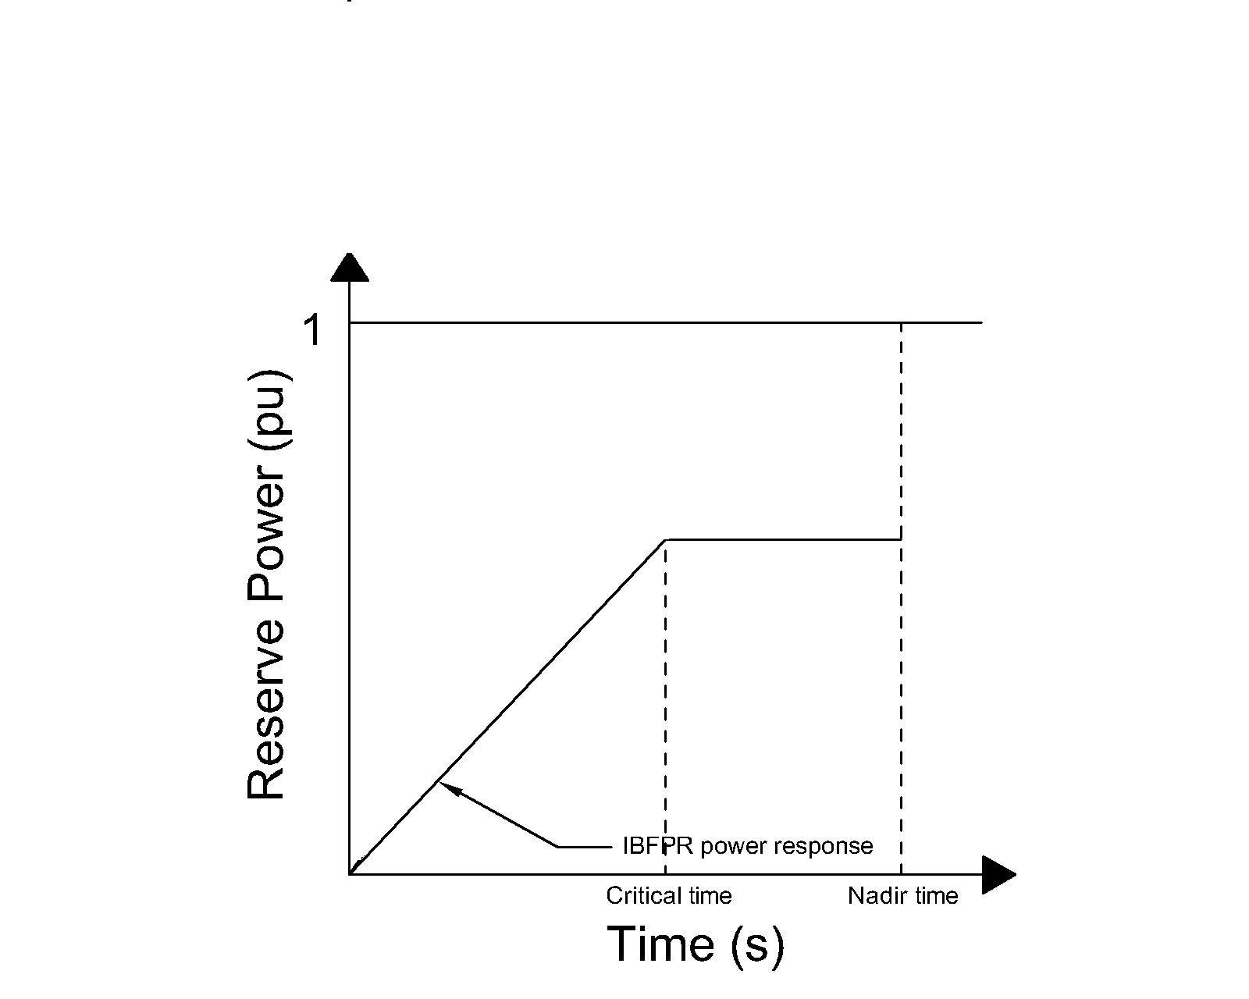
Methodology

Slide 10
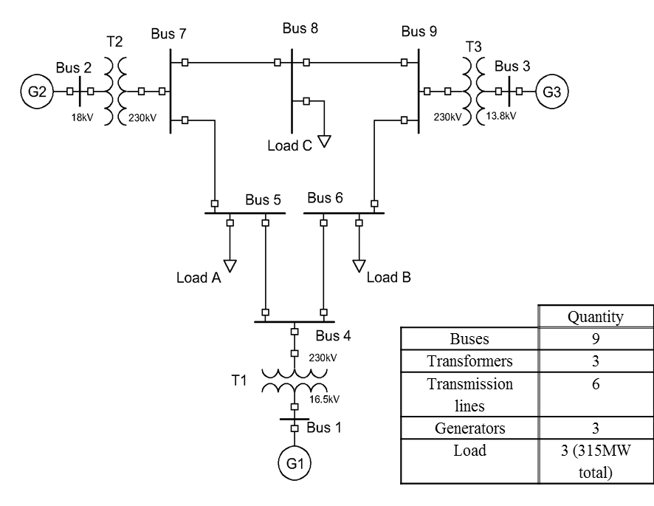
Methodology Simulation szenarios
Simplified IEEE 9 bus model
Extended IEEE 9 bus model
European electric Island Model
Based on the simplified model
It was modeled from the simplified IEEE model modifying the deployment time of the synchronous machine representation.
IEEE 9 bus model

Slide 11
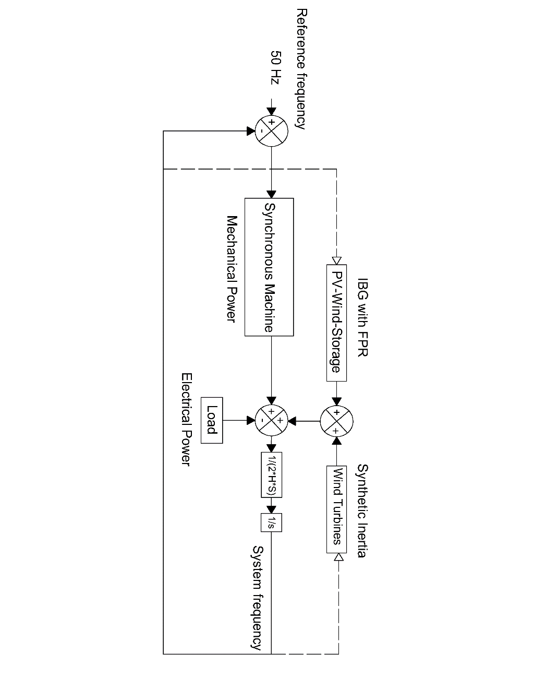
Methodology Simplified IEEE 9 bus model
Changes
Explanation
Extension
IBFPR
Synthetic Inertia

Slide 12
Agenda
Motivation
Scientific Question
Theory
Methodology
Results
Conclusion

Slide 13

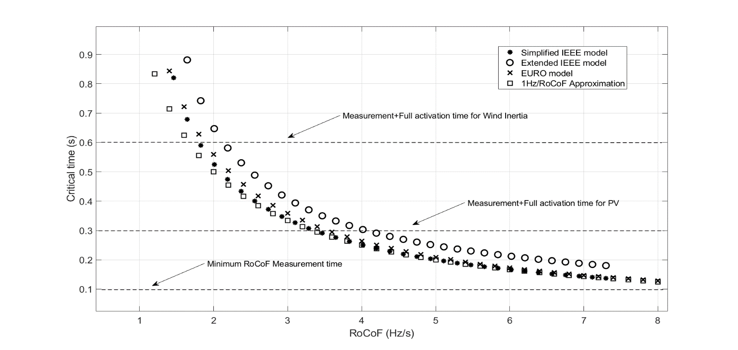
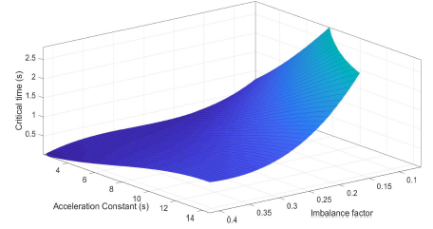
Results Critical time calculations
Critical time summary for comparison (80% IBG)
Explanation
Why you calculate the acc. time?
Comparison
Approximation
Critical time calculations, simplified model
Comparison
Approximation
My approximation works fine!!!!!!

Slide 14
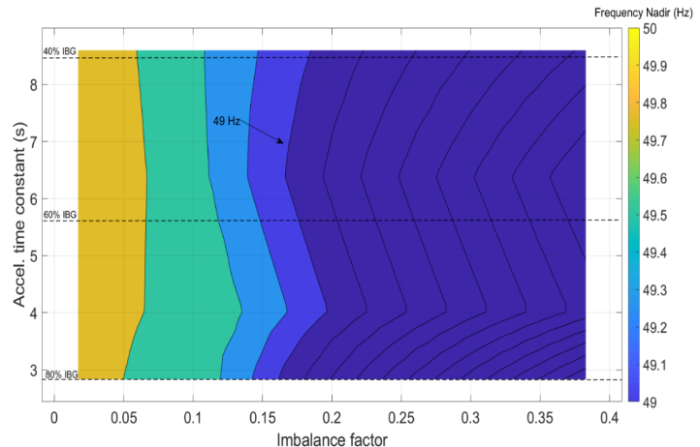
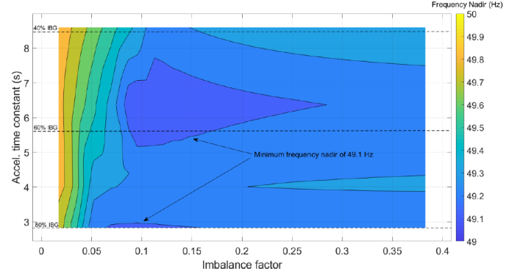
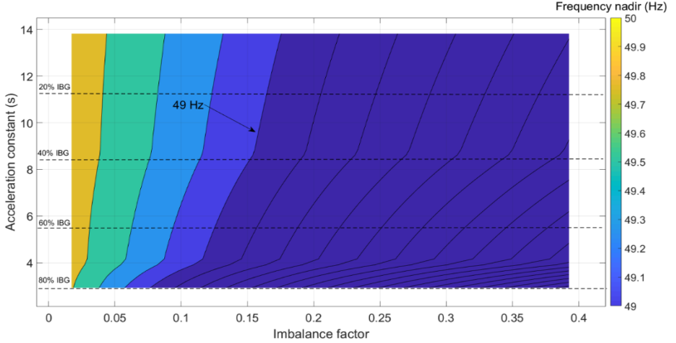
Results Including FPR and SI in Simplified Model
IBFPR basic model synthtic inertia
Major findings
Synthetic Inertia i
Major findings
Synthetic Inertia i

Slide 15
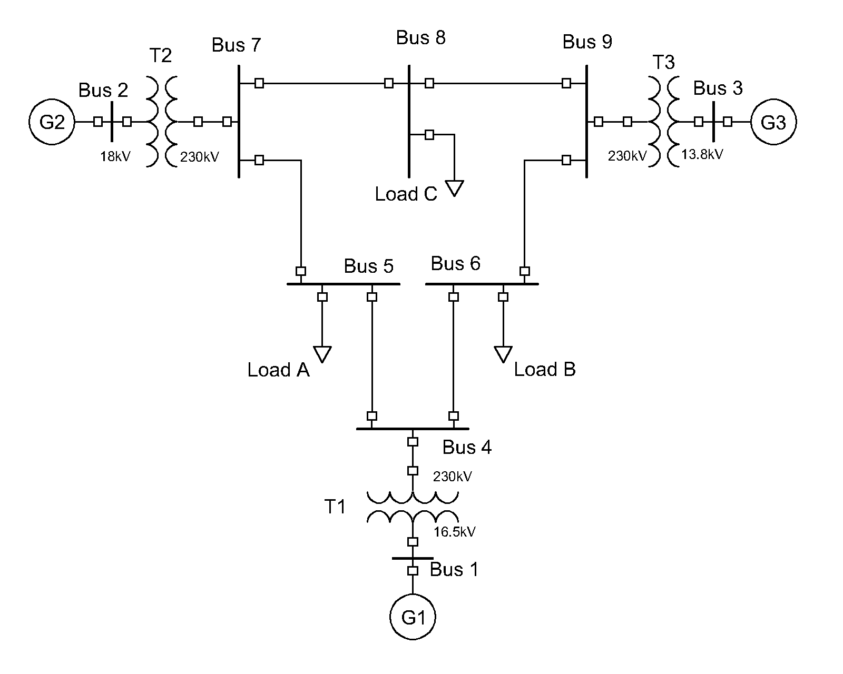
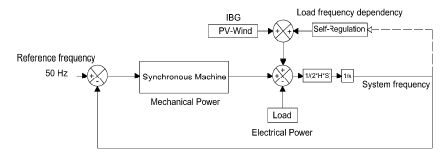
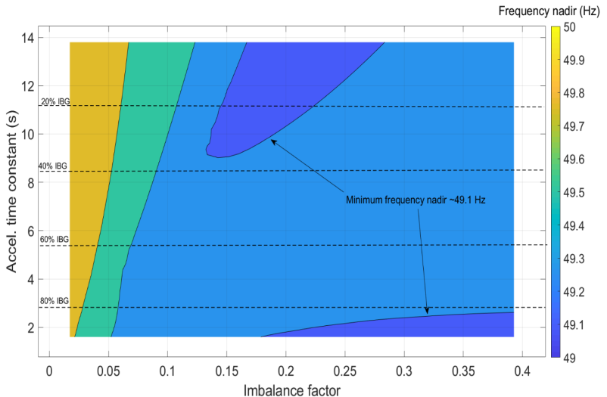
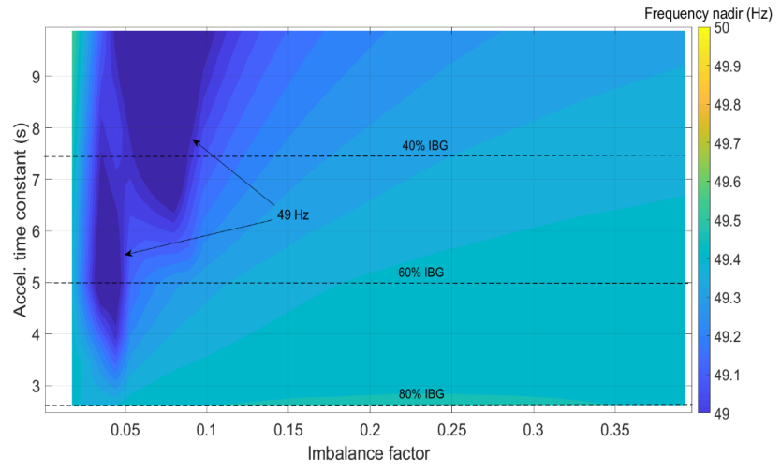
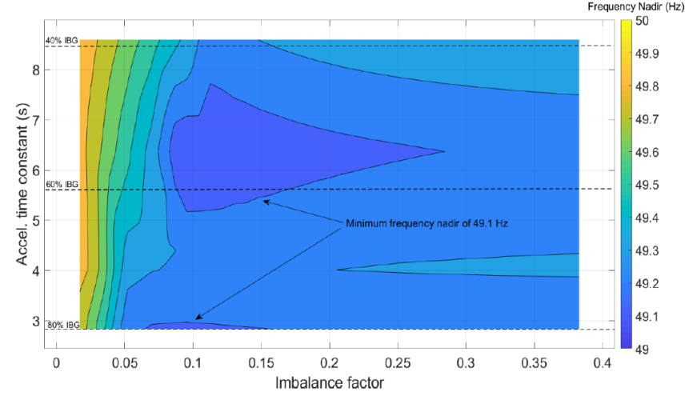
Results Including FPR in all three model szenarios
simplified extended european case
dsf
dsf
dsf

Slide 16
Results European scenario
Explanation
What’s different to the other scenario?
What’s about the areas below 49 Hz?
What does it mean in terms of grid stability of the European network?

Slide 17
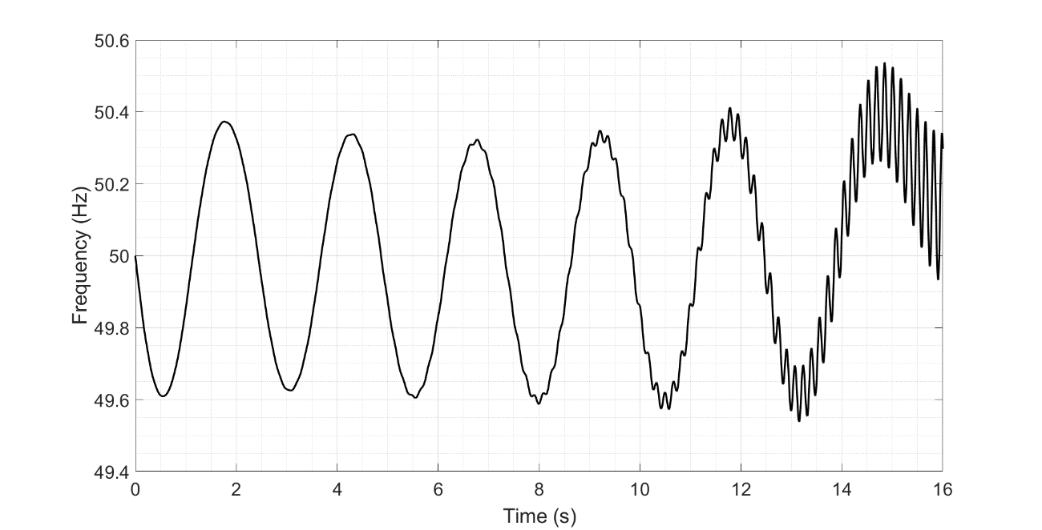
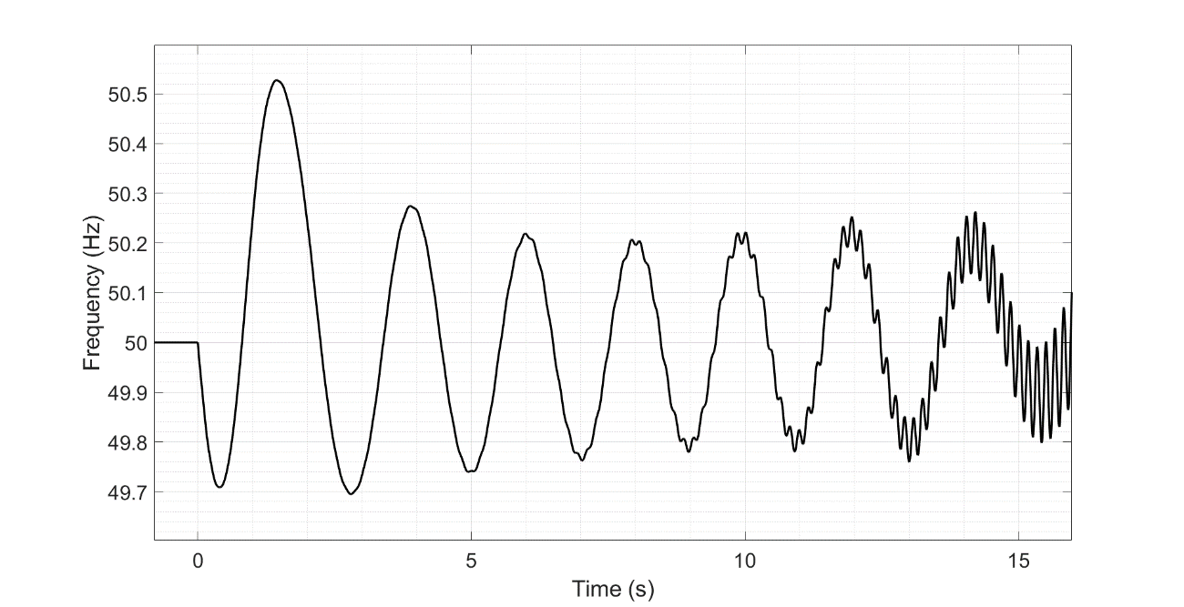
Results What happens about 80% IBG?
95% IBG and 2% imbalance. No IBFPR is provided.
95% IBG and 2% imbalance. IBFPR is provided

Slide 18
Agenda
Motivation
Scientific Question
Theory
Methodology
Results
Conclusion

Slide 19
Should be answered:
Which power reserve response would be required in future scenarios where inverter based generation is predominant?

